Slide 1


Infosys Springboard Internship 6.0
Fleet Management and Route optimization System
presented by:
1.Sanchita Mondal
2.Yamuna
3.Keerthi Padamata
4.Chinmayi
5.Rakasri

Slide 2


1. Problem Statement
Efficient fleet management is a critical challenge for organizations that operate multiple vehicles and drivers. Traditional systems often lack:
1
Centralized visibility of vehicle and driver data.
2
Real-time route analysis.
3
Clear insights into vehicle health and performance.

Slide 3
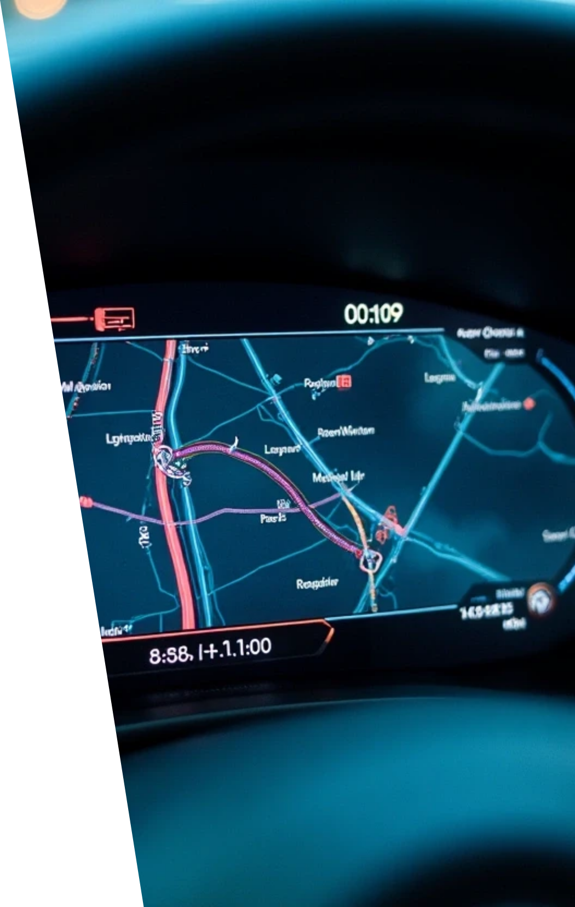
Proposed Solution – Fleet Management & Route Optimization System
The proposed system provides a centralized digital platform to manage vehicles, drivers, and bookings efficiently while offering analytical insights and static route optimization.
Key Highlights:
Centralized Dashboard: Unified view of fleet status, driver availability, and bookings
Vehicle & Driver Management: Add, update, and monitor records in real time
Manual Booking System: Gmail-linked user for trip scheduling and tracking
Vehicle Health Monitoring: Tracks engine, brakes, fuel, and performance parameters
Static Route Optimization: Calculates direct (non-traffic) distance between points
Data Visualization: Charts and reports for performance analysis
Modular Full-Stack Design: Built using React (frontend), Spring Boot (backend), and MySQL (database)
Outcome:
An integrated, scalable, and data-driven platform that simplifies fleet management, improves operational efficiency, and sets the foundation for future AI-based route optimization.

Slide 4


2. Key Features
Vehicle Management
Driver Management
Booking System
Add and view vehicle details.
Static driver data currently managed by Gmail-linked account.
Book drivers manually using your email for each trip.
Vehicle Health Check
Route Distance
Dashboard Analytics
Tracks parameters like engine, brakes, accelerator, and fuel.
Shows direct distance between points (non-traffic aware).
Displays pie and bar charts for health and driver status.

Slide 5
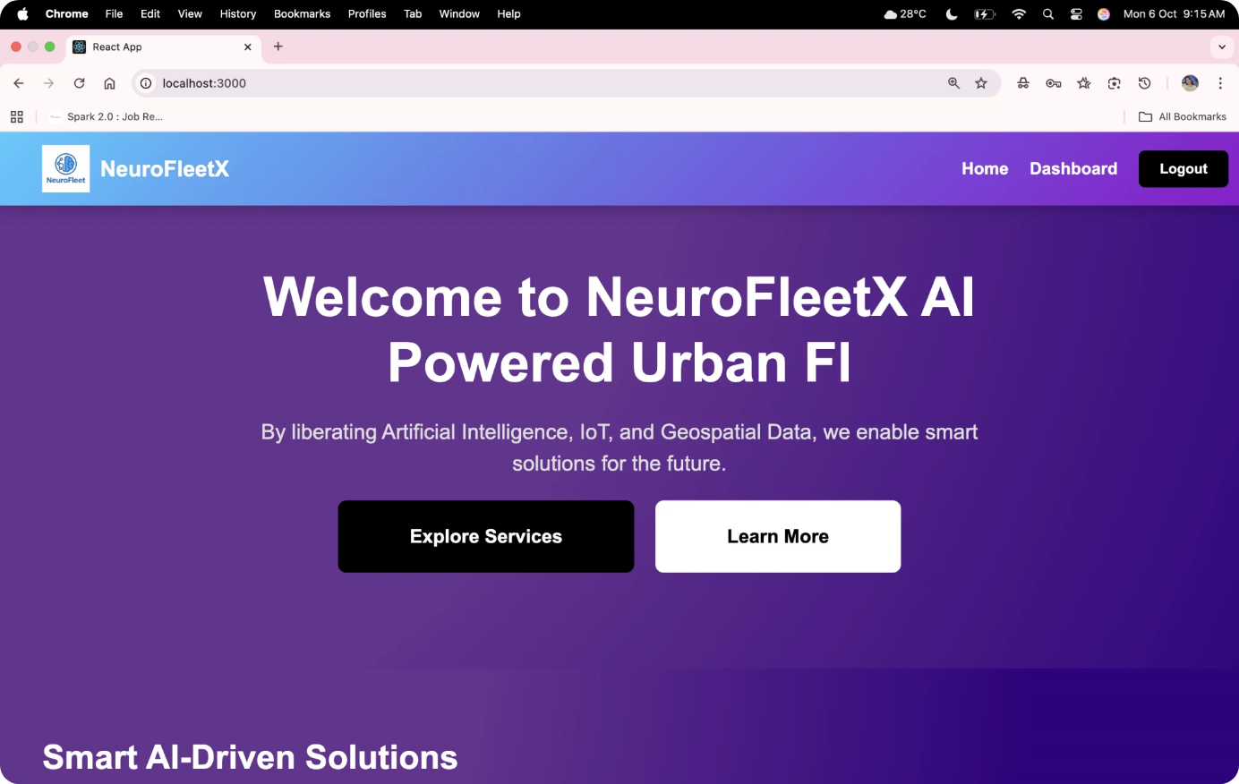
Module 1 – Login / Dashboard Page
Shows the fleet overview with status cards and charts

Slide 6
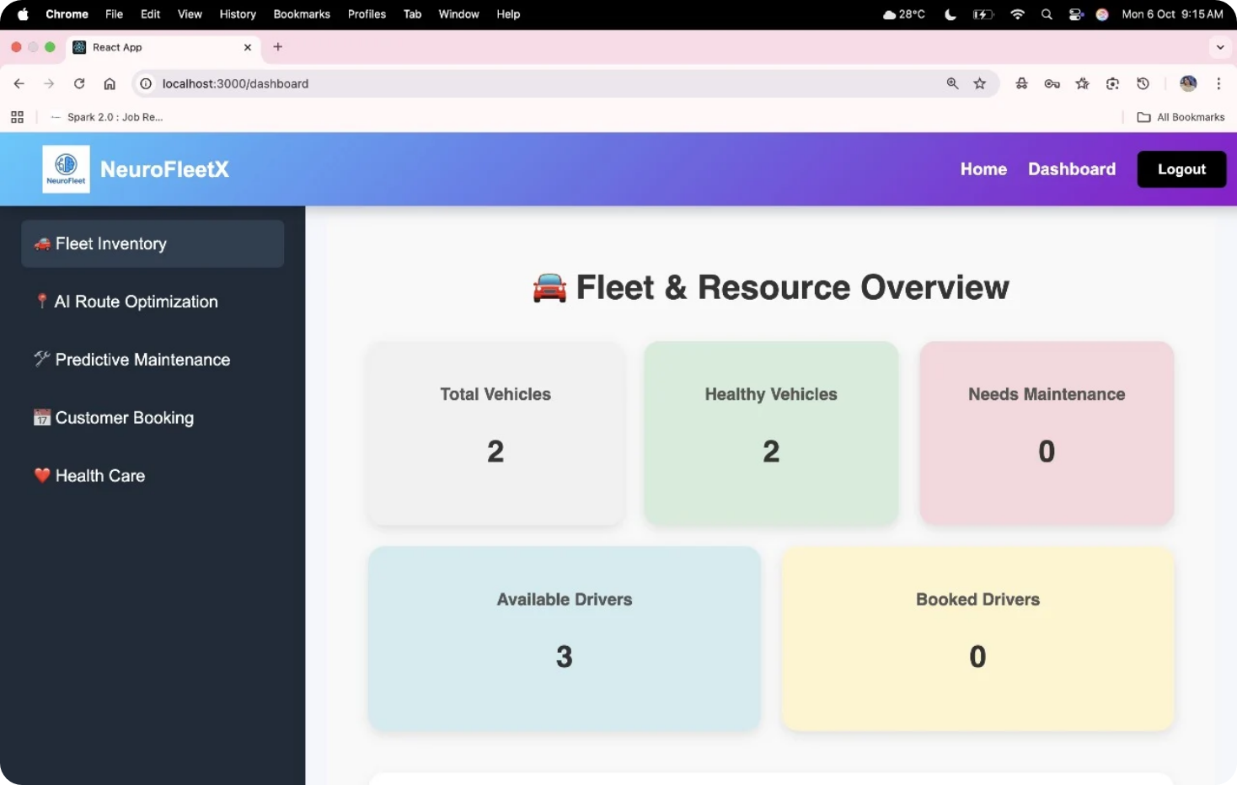
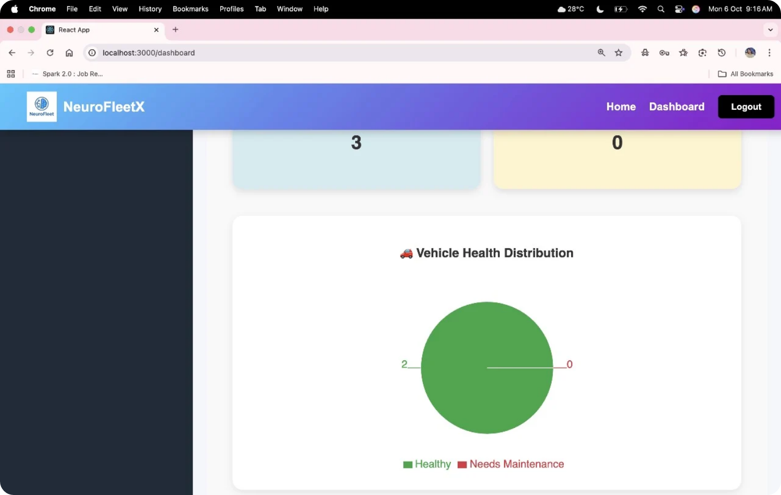
Module 2 - Fleet Inventory
Displays all vehicles, add/remove functionality and also Vehicle health distribution.

Slide 7
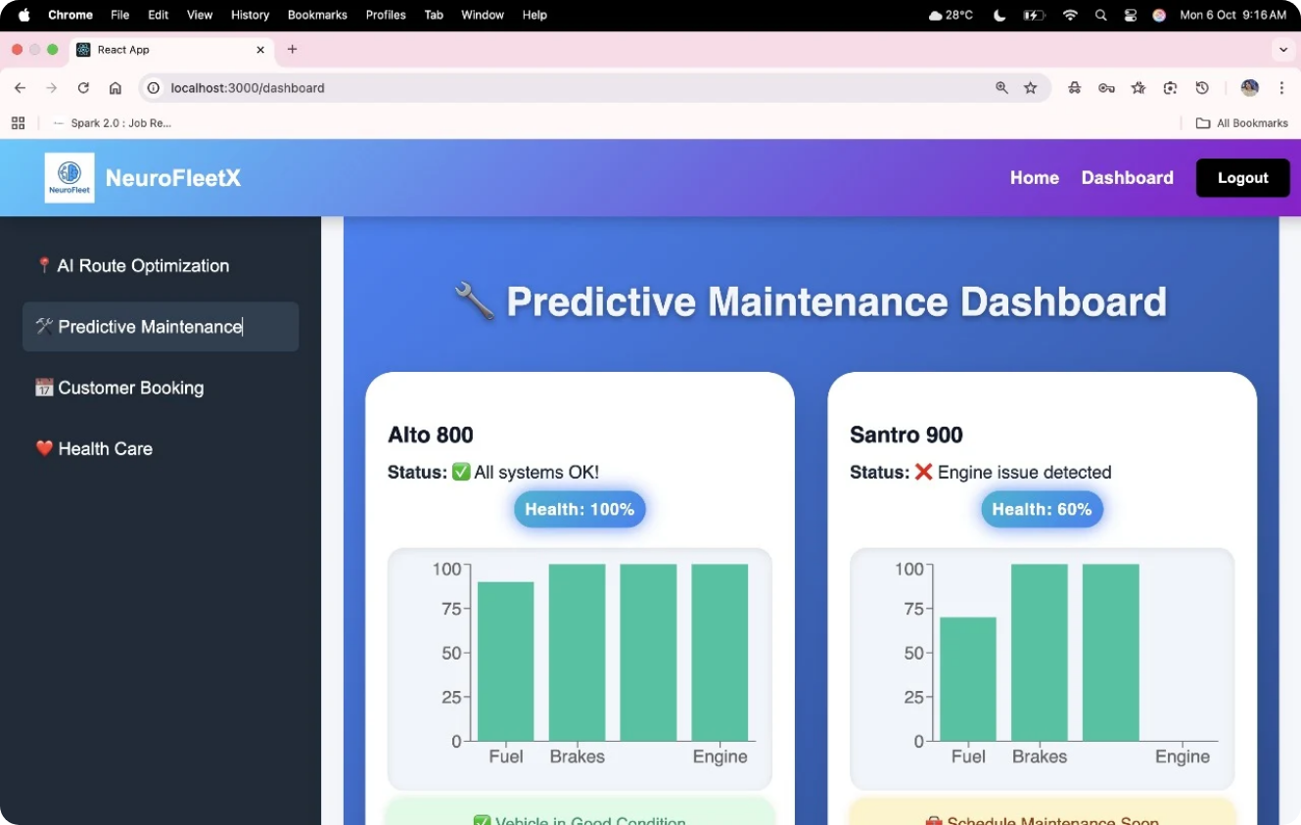
Predictive Maintenance
It will show the Status of the System

Slide 8
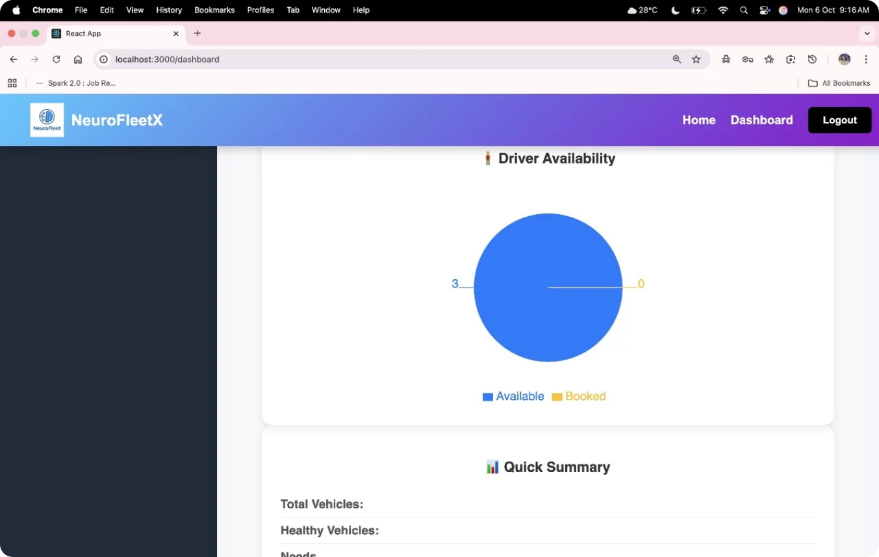
Driver Availability
Static driver list linked with your Gmail account.

Slide 9
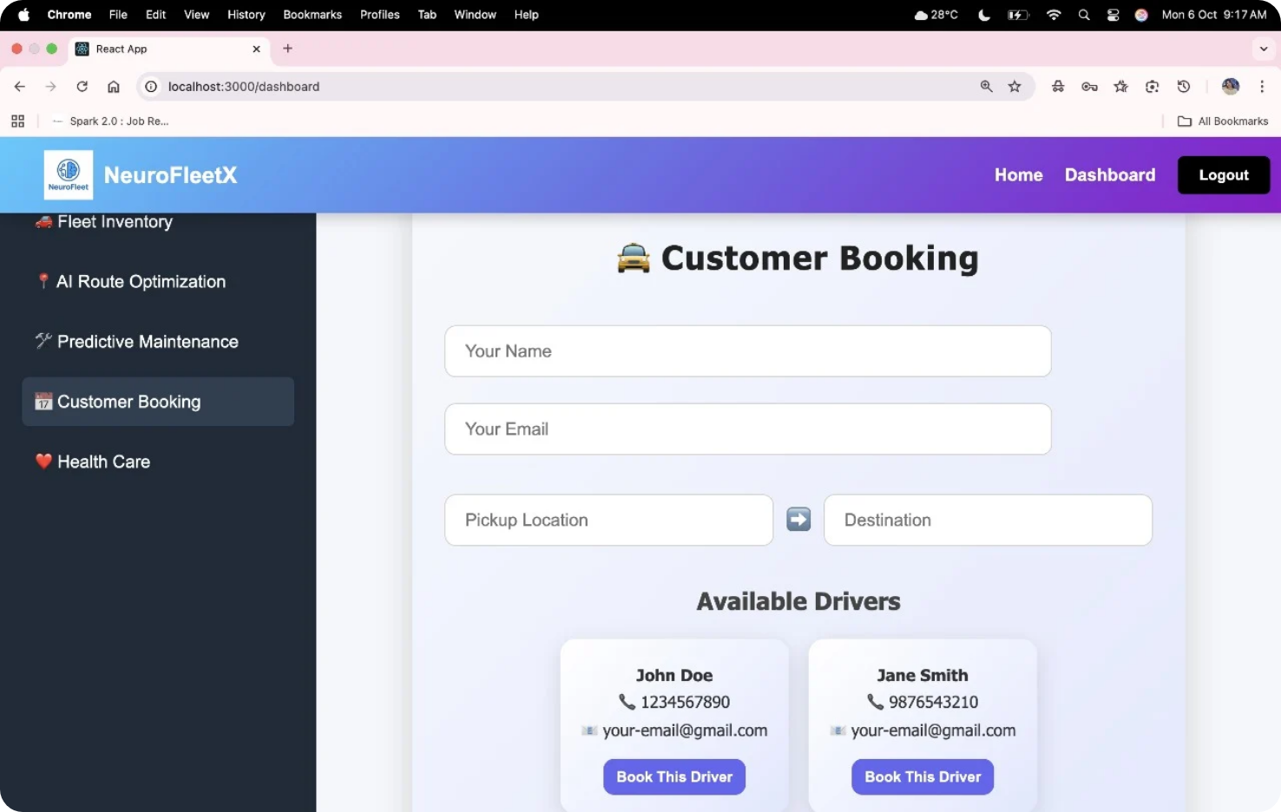
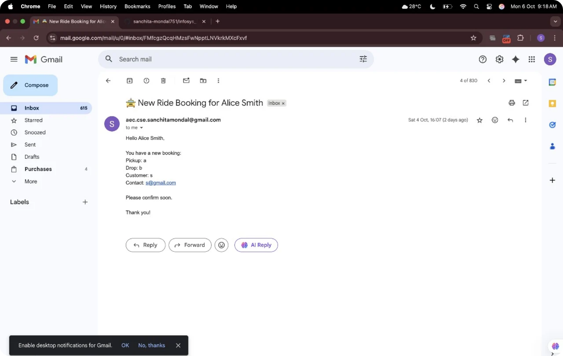
Module 3 – Booking System
Manual booking using Gmail-linked user ID.

Slide 10
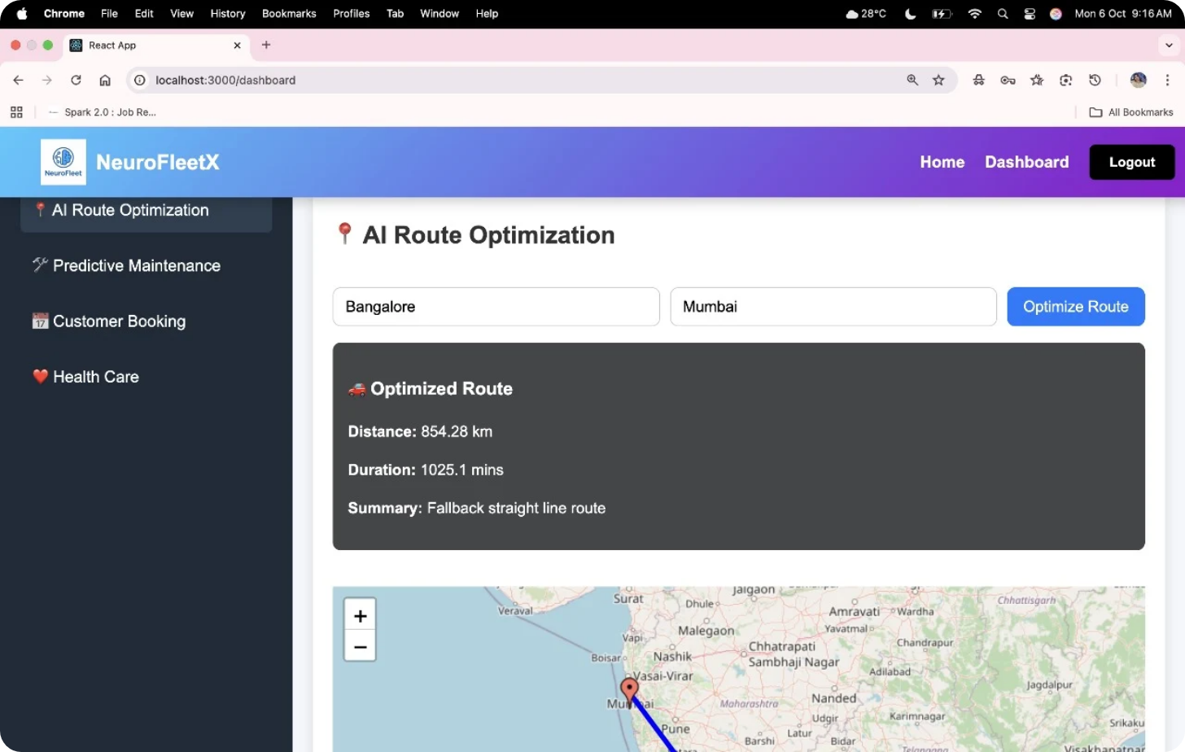
AI - Route Optimization
Static path distance displayed between two selected points.

Slide 11
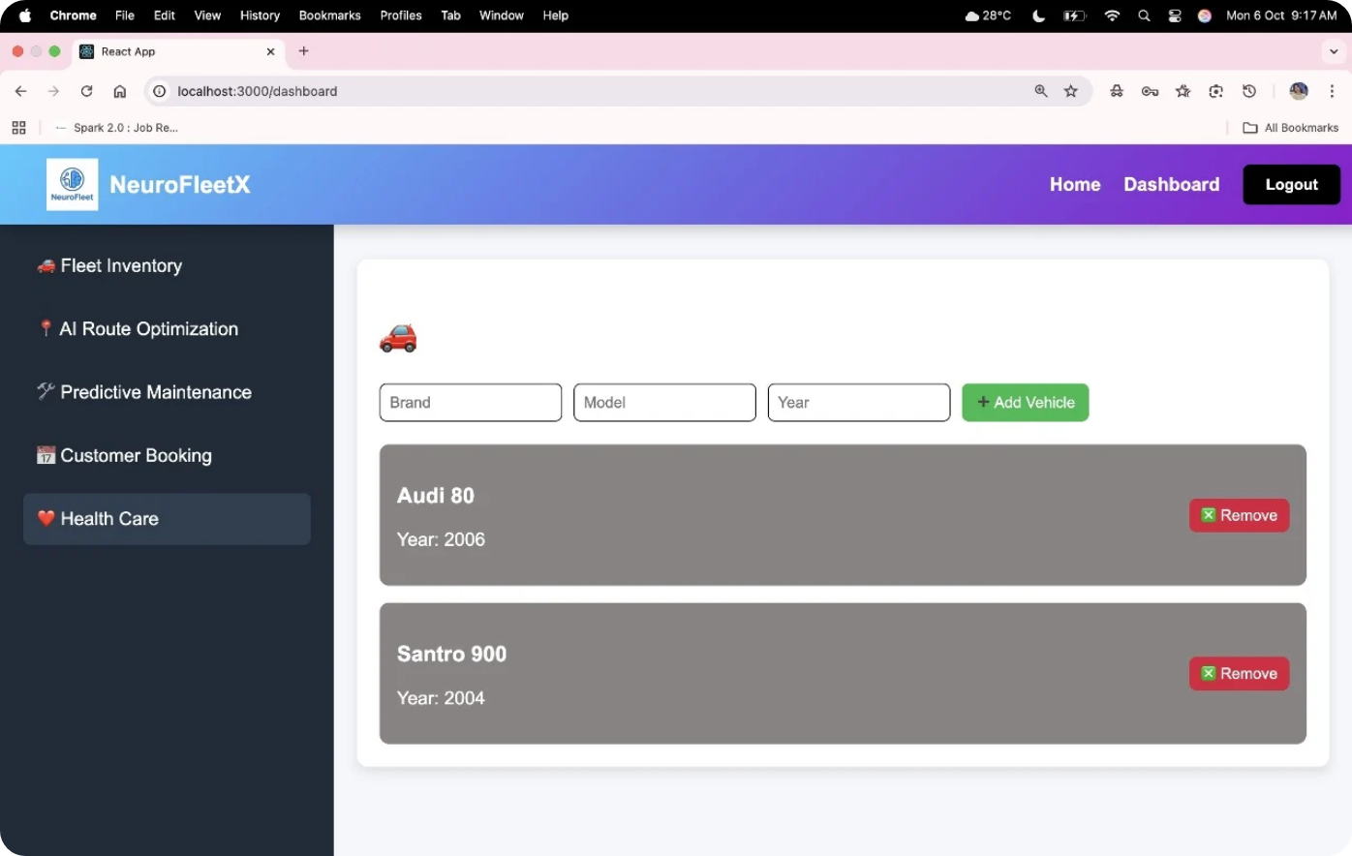
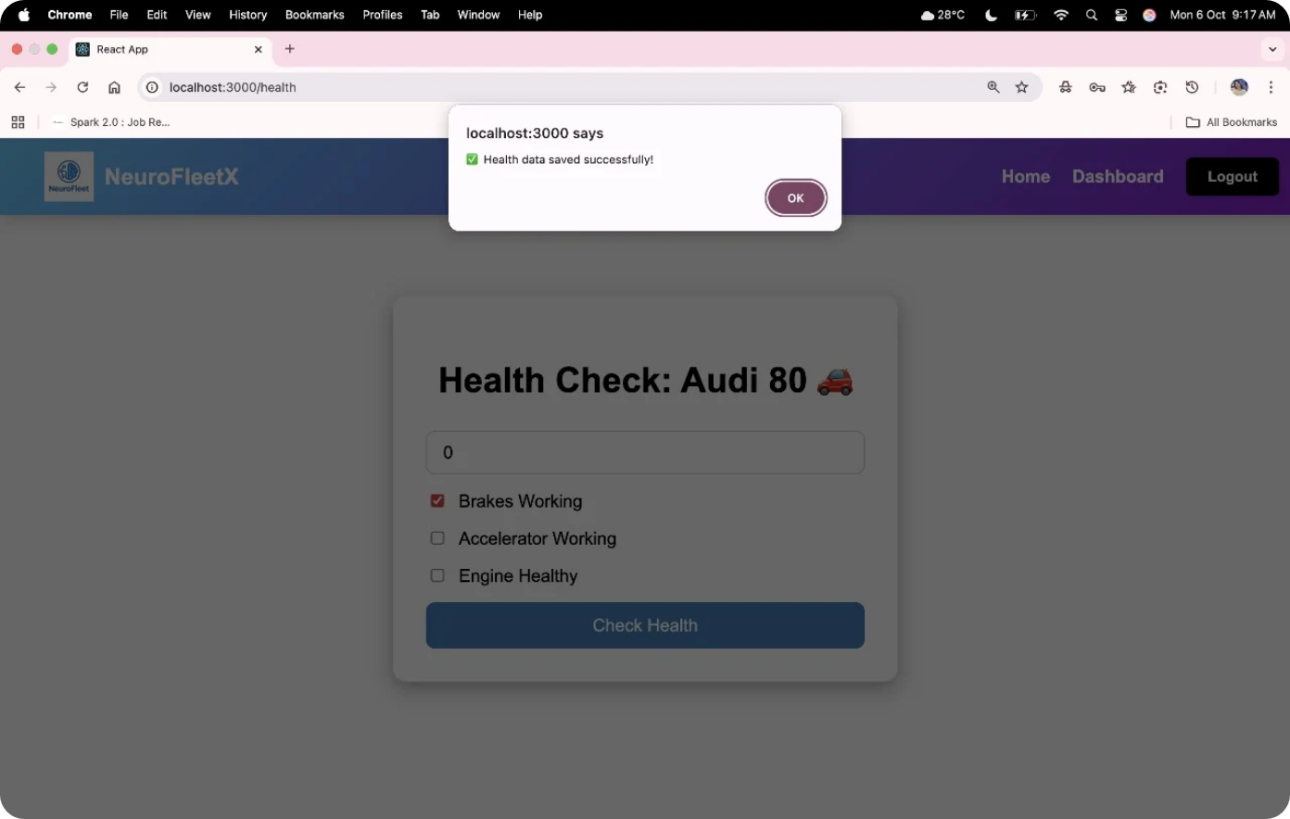
Module 4 - Health Care
It will check the health of the particular vehicle

Slide 12
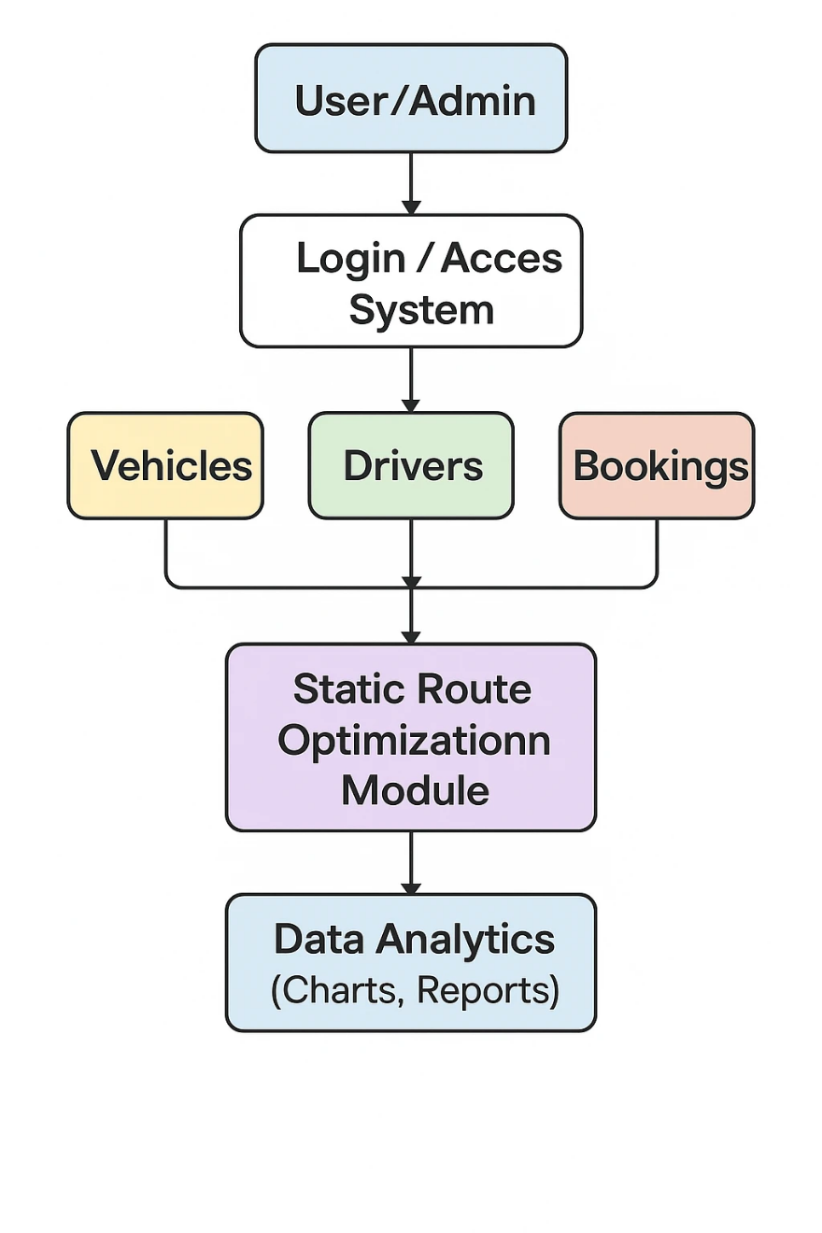
4. UML Diagram / System Flow
Here’s the logical system flow you can include as a diagram:
1.User/Admin – Access the system.
2.Login/Access System – Authenticates and authorizes users.
3.Vehicles, Drivers, Bookings – Core modules for fleet details, driver info, and trip management.
4.Static Route Optimization Module – Optimizes routes using data from the above modules.
5.Data Analytics – Generates charts and reports for performance insights.

Slide 13
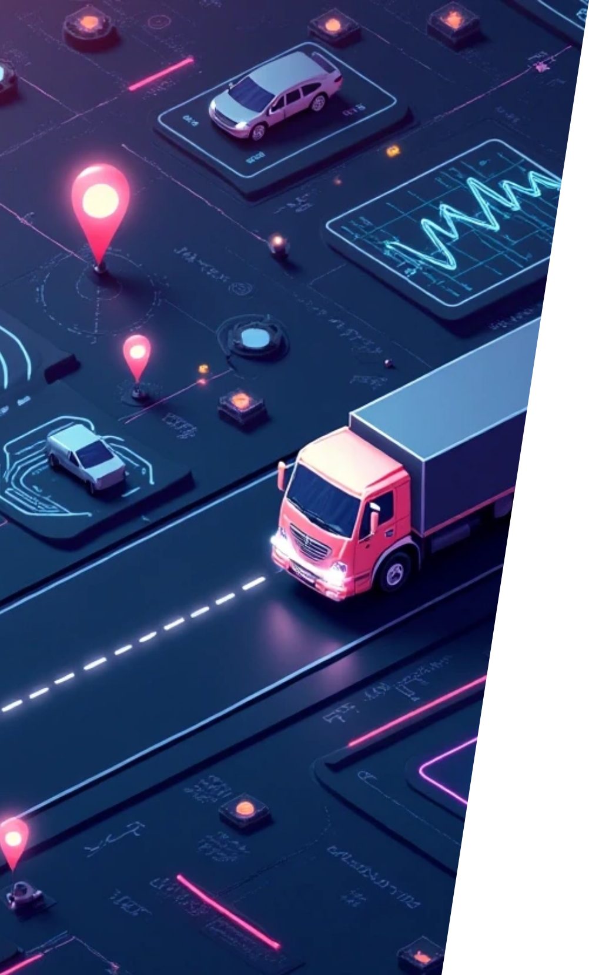





5. Future Enhancements
We plan to enhance the project in the following ways:
1
2
Integration with Spring AI and LLM Models
Dynamic Driver Availability System
To recommend optimized routes dynamically using contextual and historical data.
Allow drivers to log in and mark their availability in real-time.
3
4
Role-Based Authentication
Predictive Maintenance Alerts
Introduce worker, driver, and admin roles with secure access.
Notify the admin when a vehicle’s health drops below threshold.
5
Live Traffic Integration (Google Maps / AI Models)
Replace static distances with real-world dynamic routing.

Slide 14
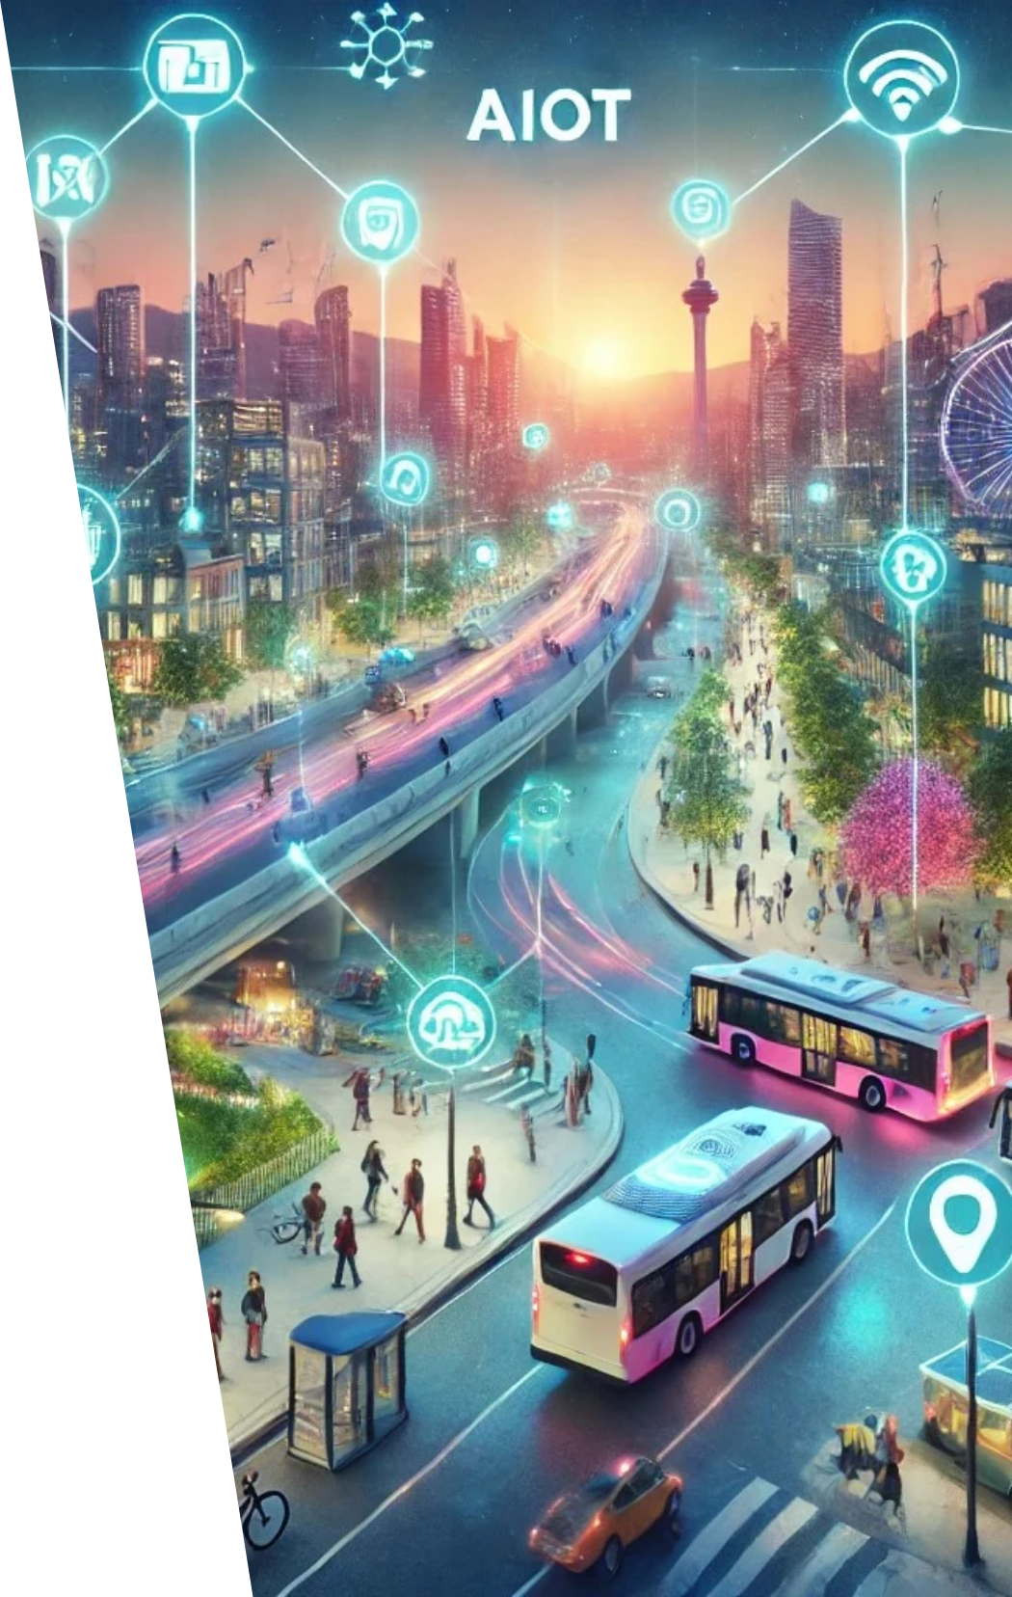

6. Conclusion
The Fleet Management and Route Optimization System successfully demonstrates how a modular full-stack architecture can simplify complex fleet operations.
We achieved:
Centralized management of vehicles and drivers.
Static route optimization and trip tracking.
Visual analytics using charts and reports.
A scalable architecture ready for AI-based extensions.
In essence:
Our project lays the groundwork for an intelligent fleet management platform — from simple static route calculations today, to AI-driven logistics intelligence tomorrow.

Slide 15

Thank You

